Slide 1

COMPUTER NETWORKS PRESENTATION
TERAHERTZ COMMUNICATIONS

Slide 2
Terahertz Communications
Terahertz (THz) transmission is a complementary wireless technology for communication networks, which allow high-speed wireless extension of the optical fibers for Beyond 5G.
They are eminent as key aiding technology for next generation wireless systems that assures to integrate a wide range of data demanding and delay sensitive applications.
We will illustrate how it results in improved environment aware system performance in beyond 5G use cases.

Slide 3
Introduction
The terahertz band (0.3 thz to 10 thz) is the next edge in wireless communications for its knack to expose significantly wider divisions of unutilized bandwidth.
Terahertz bands can be used as mobile backhaul for transferring large bandwidth signals between base stations.
There is nothing a lot to explain about terahertz communications because the industry is currently preoccupied with millimeter (mm) wave frequency bands (30 ghz to 300 ghz) to offer (gbps) data rates for 5G mobile devices.

Slide 4
Introduction
More importantly, terahertz bands can be employed in close-in communications, also known as whisper applications. That includes wiring harnesses in circuit boards and vehicles, nanosensors, and wireless personal area networks (W-PAN).
There are applications like high resolution spectroscopy and image and communication studies that require short range communications in the form of massive bandwidth channels with zero error rate in crucial areas.

Slide 5
Benefits or advantages of Terahertz (THz)
➨It offers greater bandwidth than microwave frequencies. The data bandwidth exceeds wireless protocols e.g. 802.11b.
➨THz radiation waves can easily pass through non-conducting materials as mentioned above.
➨It can be used in image sensing and higher bandwidth wireless networking systems for distances of about 10 to 100 meters.
➨It has minimum effects on human body as it is non-ionizing in nature.

Slide 6
Drawbacks or disadvantages of Terahertz (THz)
➨It does not support long range communication due to scattering and absorption by cloud, dust, rain etc.
➨It supports less penetration depth than microwave radiation. Moreover it has limited penetration through clouds and fog. THz waves can not penetrate liquid water or metal.
➨It is difficult to detect terahertz frequencies as black body radiation at room temperatures is very strong at these frequencies.
➨Sources, detectors, modulators are not available at affordable prices which lead to hindrances in its commercial availability as communication system.

Slide 7
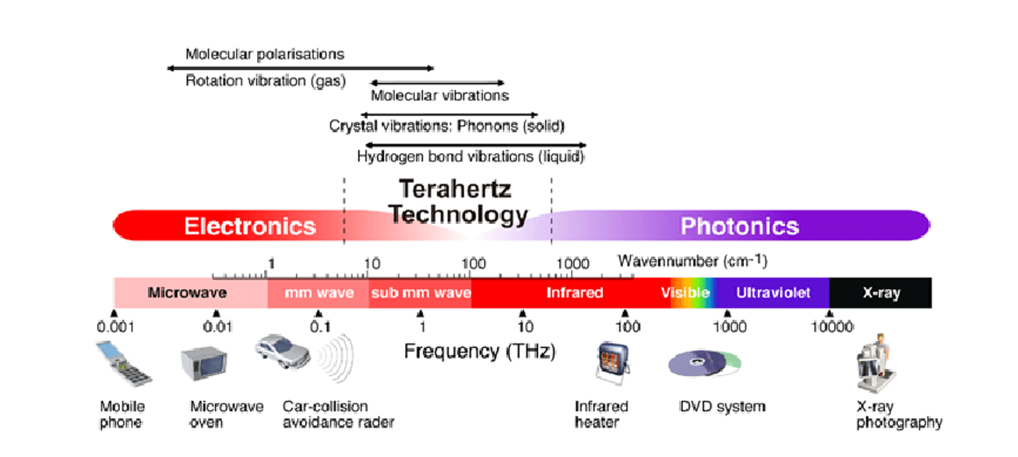
The above-mentioned use cases provide a glimpse of how terahertz communications can be a game changer by offering even lower latency than fiber networks. Additionally, they can complement mmWave communications in indoor wireless networks and gigabyte WiFi support of internet of things(IoT) applications.

Slide 8
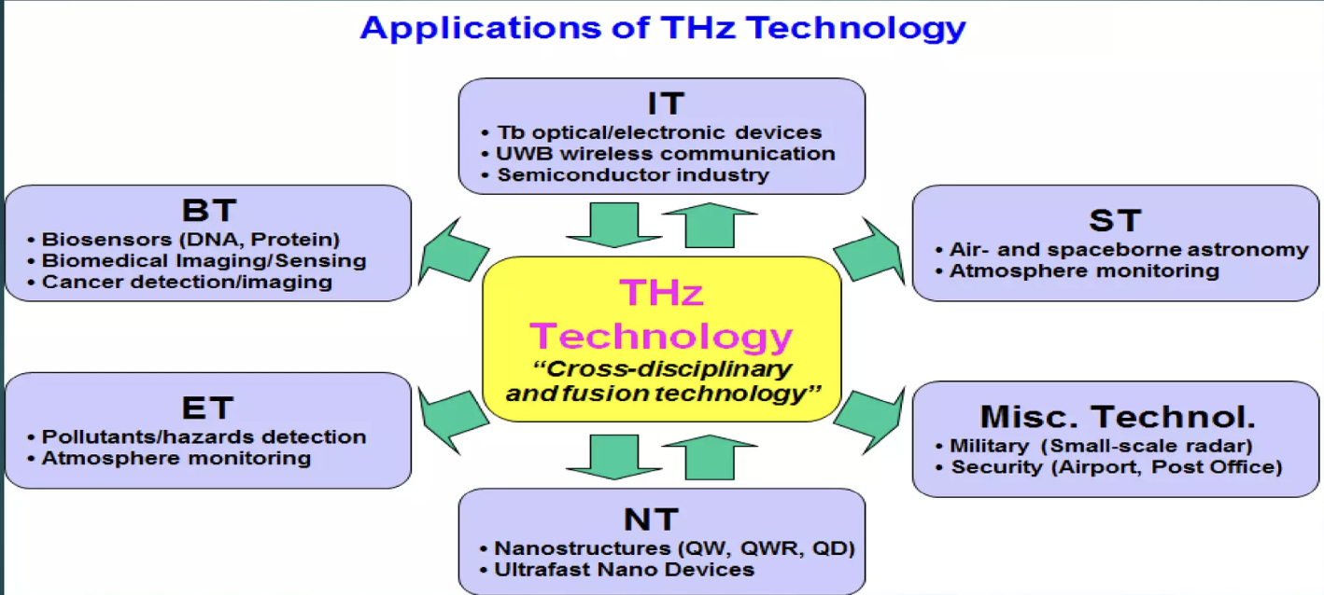
Applications
THz sensing and imaging applications
Localization
5G and beyond cases
Vehicle and drone to drone communications
Implementation aspects:
Roles in machine learning
Health and privacy concern

Slide 9
Challenges with THz communication
Many challenges need to be addressed prior to the widespread introduction of THz communications. For instance, the THz band’s high propagation losses and power limitations result in very short communication distances, and frequency.
Signal misalignment and blockage are also more severe at the THz band.
THz channel is dominated by a line-of-sight because of significant signal reflection losses and very high signal diffraction and scattering losses.

